Slide 1
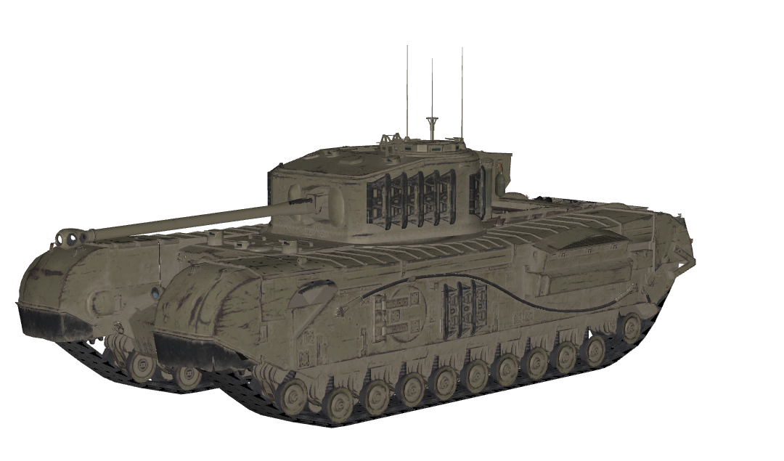
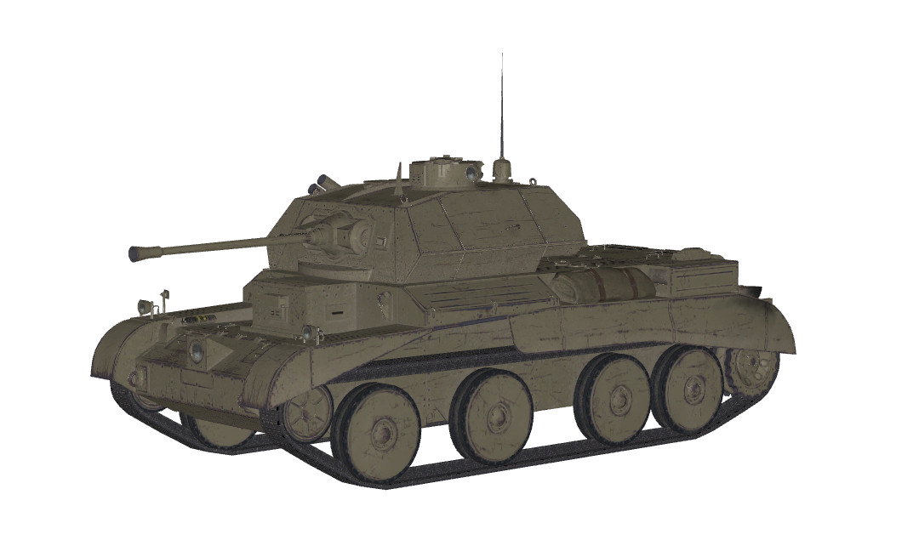
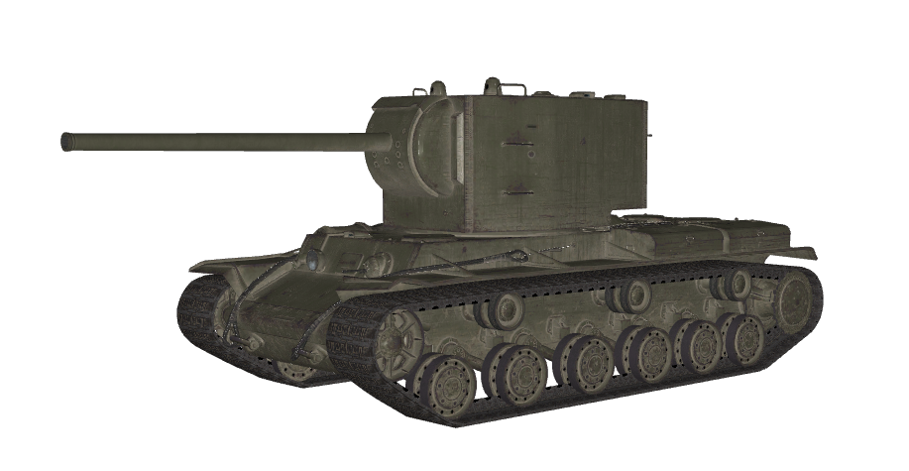


Churchill VII
Cruiser IV
KV-2
Type: Heavy
Nation of Origin: Britain
First Produced: 1942
Health: 1000
Firepower: 200
Reload Time: 3.5 seconds
Top Speed: 24 km/h
Strong but slow.
Type: Light
Nation of Origin: Britain
First Produced: 1941
Health: 400
Firepower: 100
Reload Time: 2.5 seconds
Top Speed: 45 km/h
Light and fast, but lacks firepower.
Type: Heavy
Nation of Origin: USSR
First Produced: 1940
Health: 1200
Firepower: 600
Reload Time: 9 seconds
Top Speed: 20 km/h
Poor mobility but monstrous gun. You don’t want to get hit by one!

Slide 2
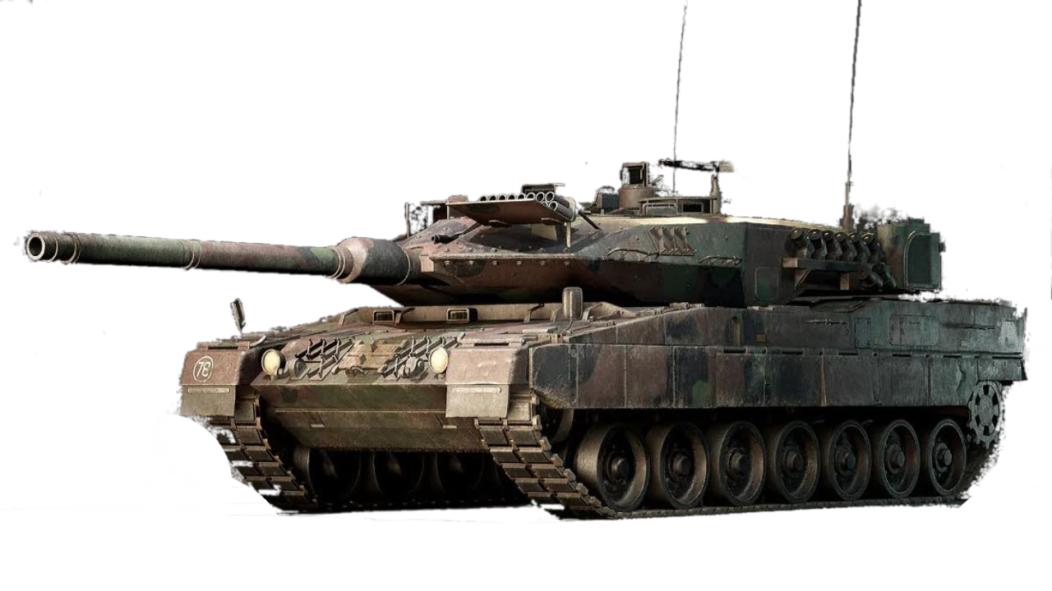
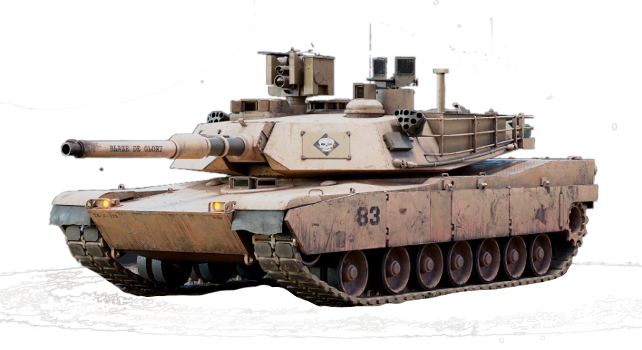
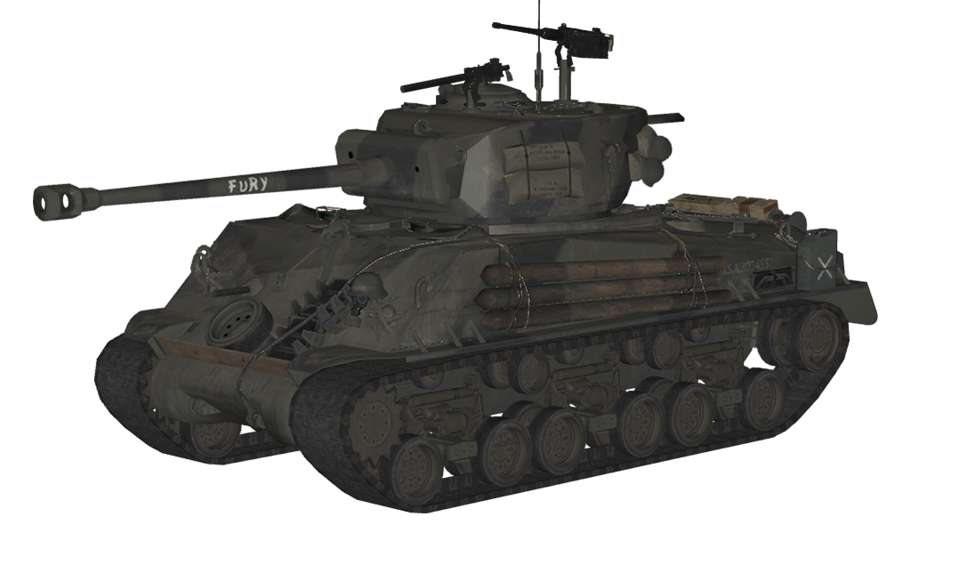
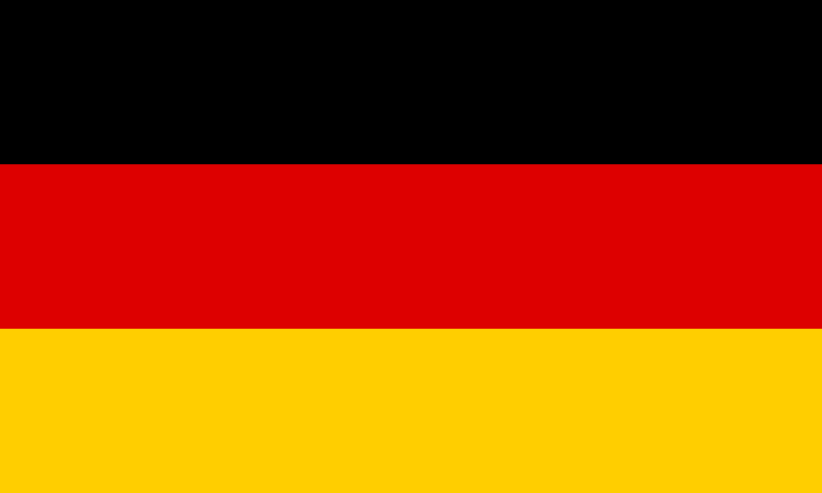

Leopard 2A7
M1A2 Abrams
M4A3E8 ‘Fury’
Type: Medium
Nation of Origin: Germany
First Produced: 2014
Health: 5500
Firepower: 1500
Reload Time: 2.5 seconds
Top Speed: 72 km/h
Fast, agile, powerful. Designed to quickly take out multiple enemies.
Type: Heavy
Nation of Origin: USA
First Produced: 1992
Health: 6000
Firepower: 1500
Reload Time: 4 seconds
Top Speed: 68 km/h
The pride of the American army. The good armour and punch from the gun makes this a dealbreaker in battles.
Type: Medium
Nation of Origin: USA
First Produced: 1940
Health: 600
Firepower: 150
Reload Time: 3 seconds
Top Speed: 40 km/h
The M4 Sherman tank from the “Fury” movie. A very balanced WW2 machine.

Slide 3
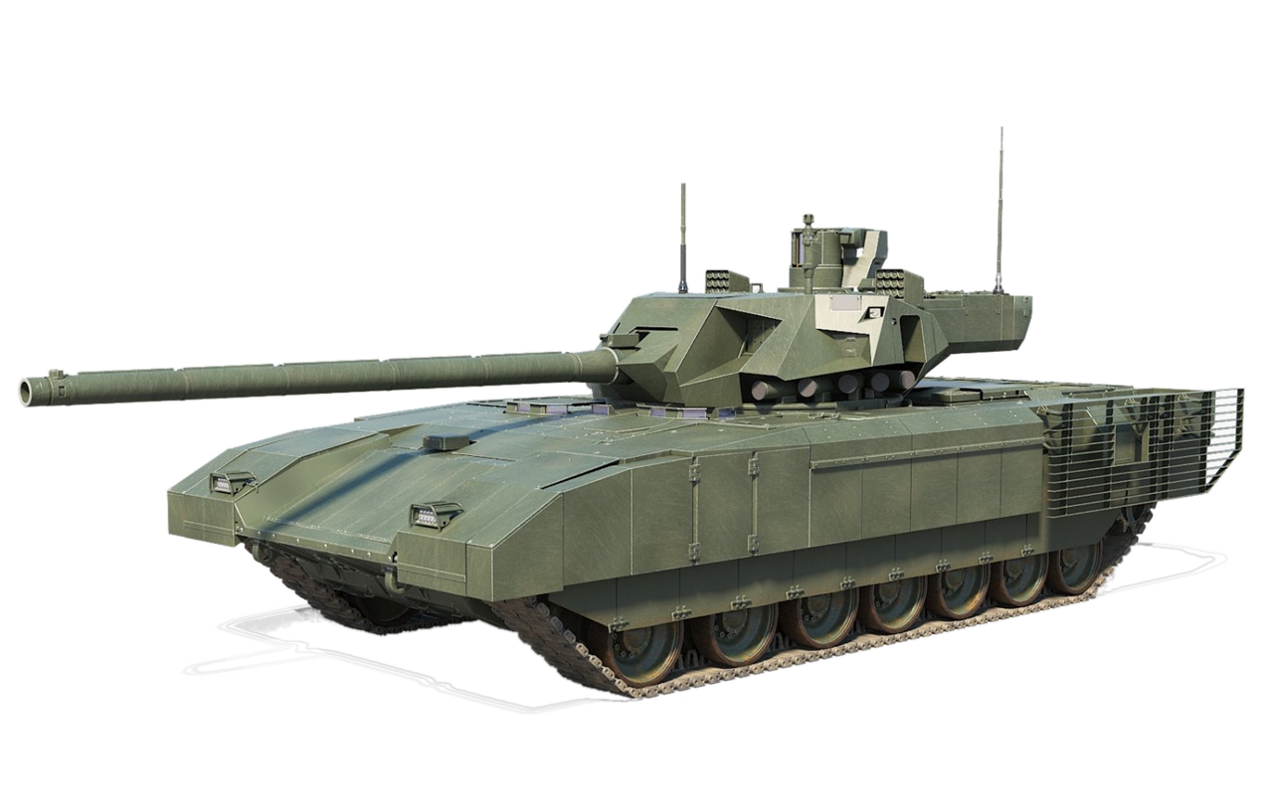
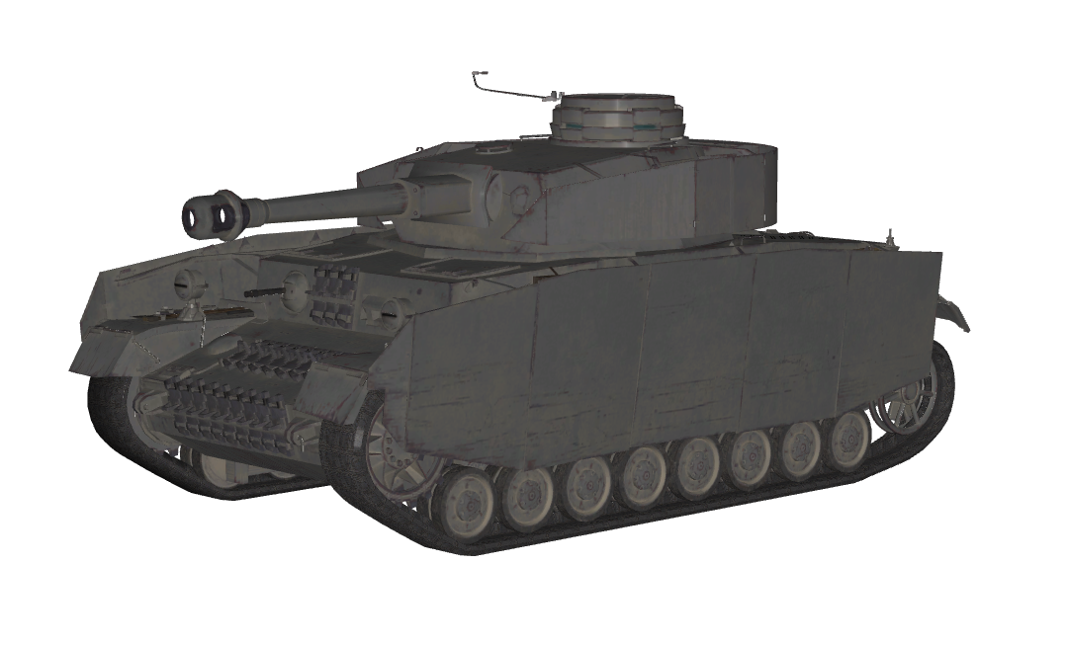
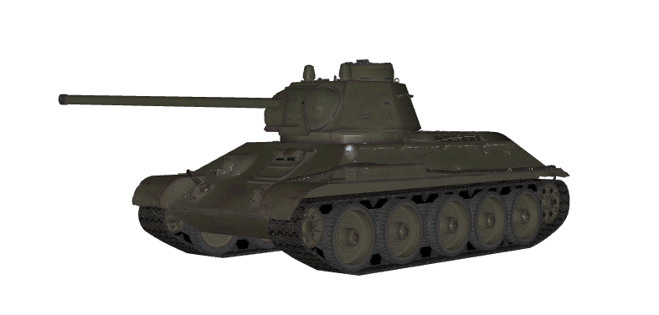

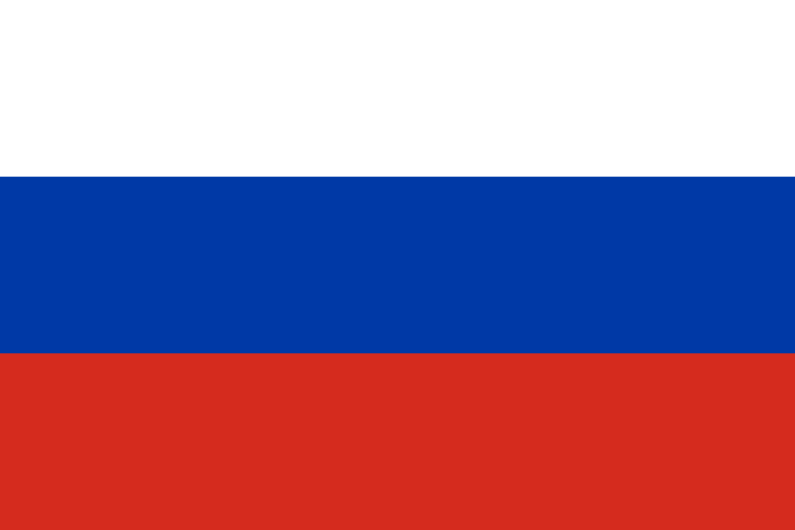
Panzer IV H
T14 Armata
T-34
Type: Medium
Nation of Origin: Germany
First Produced: 1939
Health: 600
Firepower: 160
Reload Time: 3.5 seconds
Top Speed: 35 km/h
Average German tank used in WW2.
Type: Heavy
Nation of Origin: Russia
First Produced: 2014
Health: 6000
Firepower: 2000
Reload Time: 2 seconds
Top Speed: 75 km/h
The most high tech Russian tank. This monster is equipped with excellent mobility, tough protection and insane firepower.
Type: Medium
Nation of Origin: USSR
First Produced: 1940
Health: 400
Firepower: 150
Reload Time: 3 seconds
Top Speed: 50 km/h
The most produced tank in history. The simplicity of its engineering made it reliable and cheap to mass produce.

Slide 4
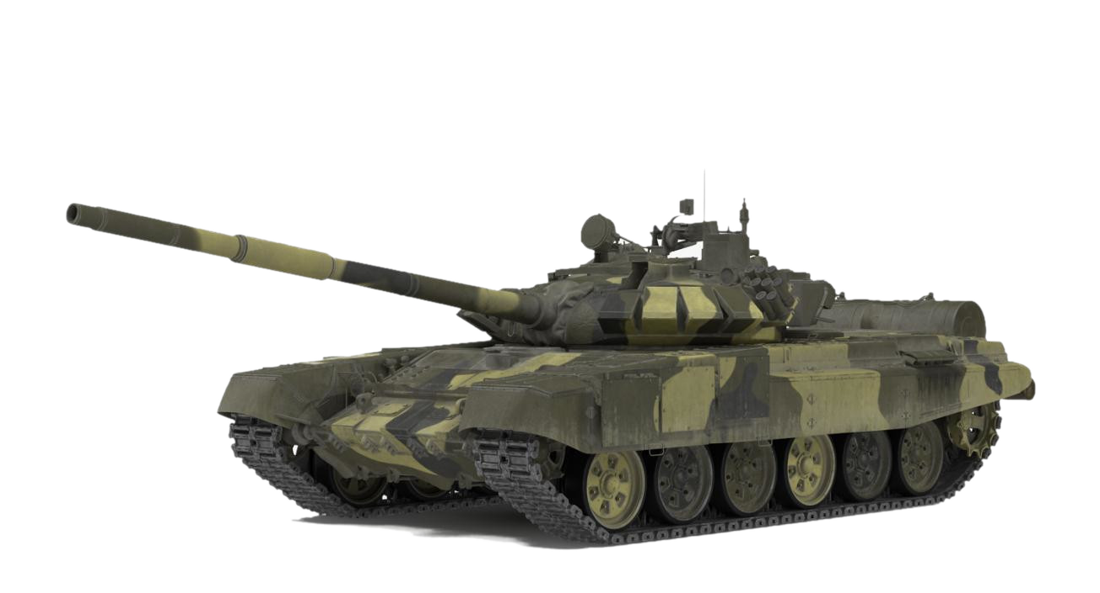
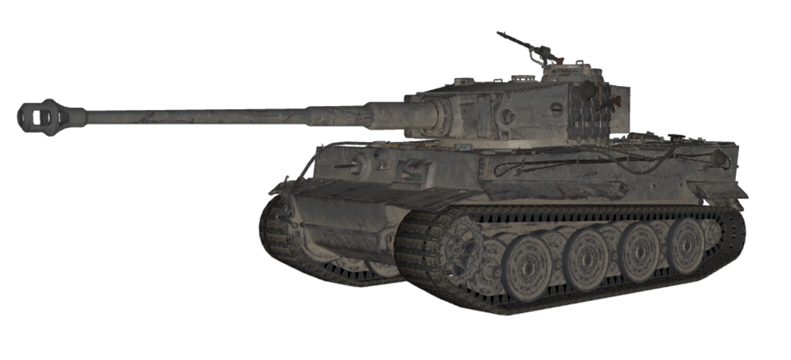
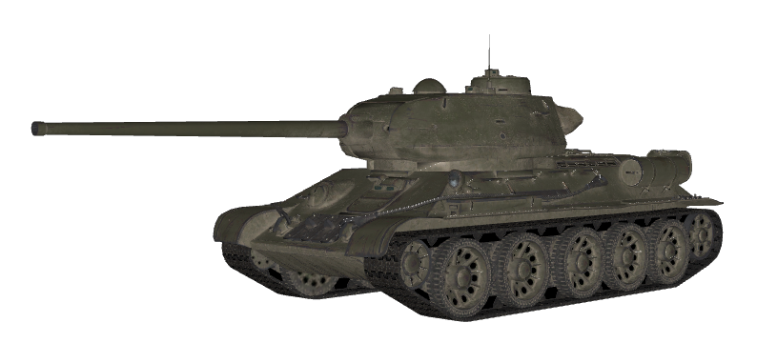
T-72
Tiger I
T-34-85
Type: Medium
Nation of Origin: USSR
First Produced: 1969
Health: 2000
Firepower: 500
Reload Time: 3.5 seconds
Top Speed: 65 km/h
Classic cold-war era tank.
Type: Heavy
Nation of Origin: Germany
First Produced: 1942
Health: 1600
Firepower: 500
Reload Time: 6 seconds
Top Speed: 45 km/h
Tough armour and powerful gun. One of the Third Reich’s most feared weapons.
Type: Medium
Nation of Origin: USSR
First Produced: 1944
Health: 400
Firepower: 200
Reload Time: 3 seconds
Top Speed: 50 km/h
A T-34 with an improved turret and an 85mm gun.

Slide 5
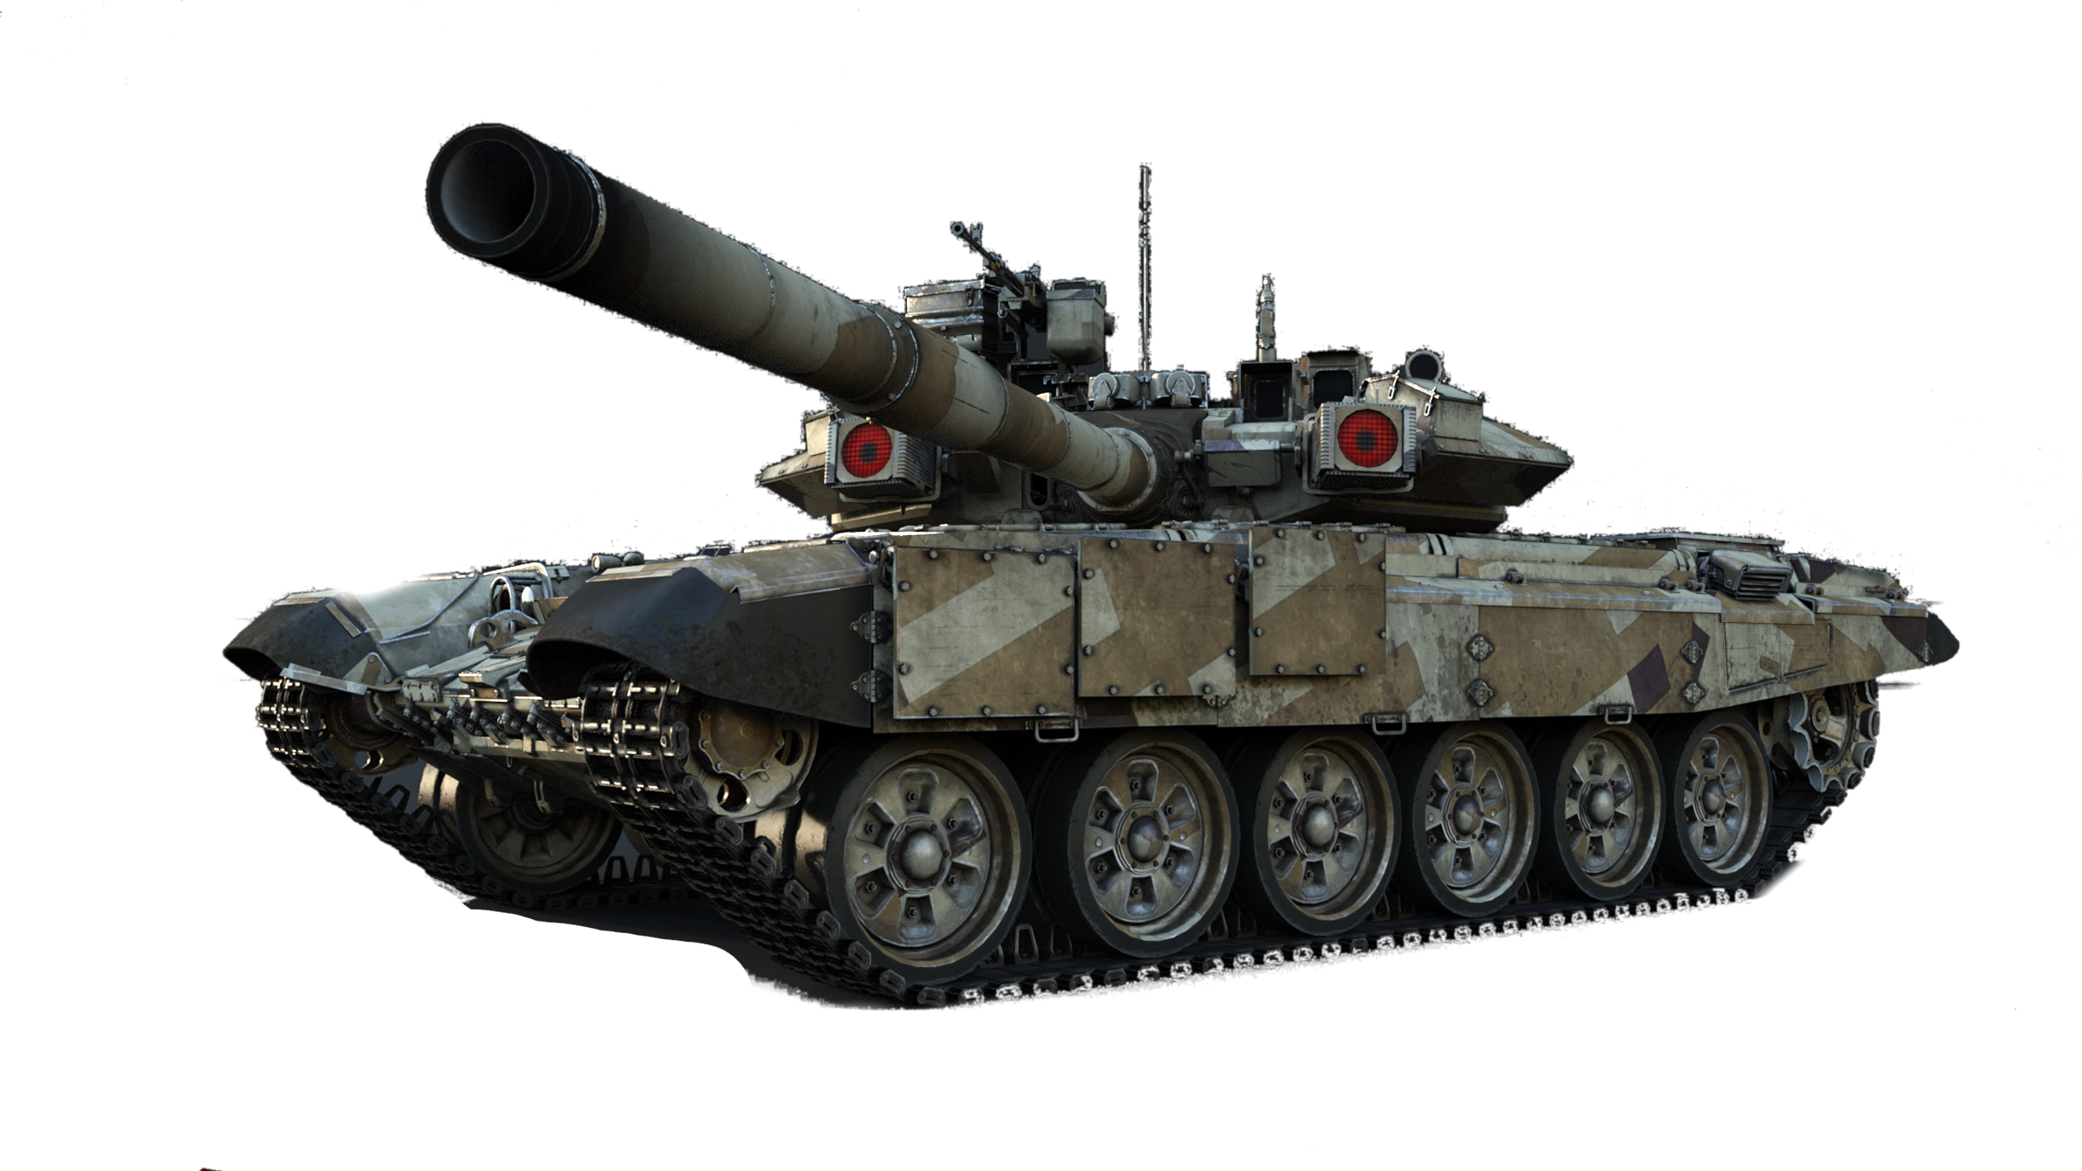
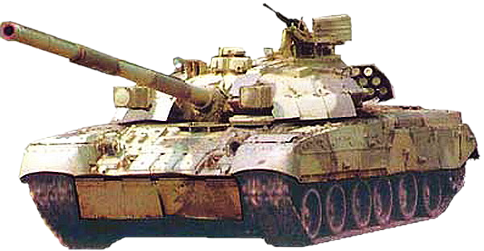
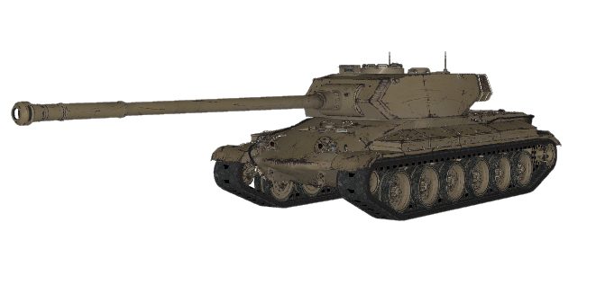
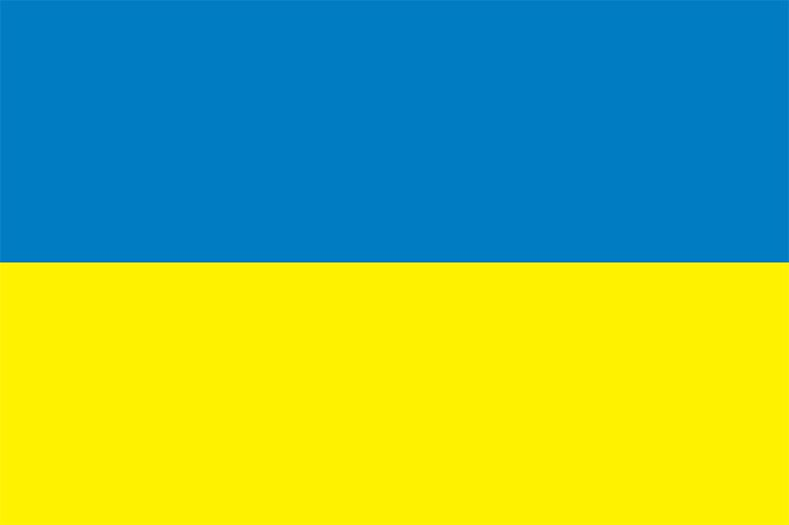

T-90
T-84
Progetto 54
Type: Heavy
Nation of Origin: Russia
First Produced: 1992
Health: 3000
Firepower: 800
Reload Time: 3 seconds
Top Speed: 60 km/h
Russia’s current main battle tank. More modern variants of this model are produced and used in the Invasion of Ukraine.
Type: Heavy
Nation of Origin: Ukraine
First Produced: 1994
Health: 3600
Firepower: 1000
Reload Time: 3 seconds
Top Speed: 60 km/h
Ukrainian tank based on the Soviet T-80. Good armour and penetration.
Type: Heavy
Nation of Origin: Italy
First Produced: 1954
Health: 2500
Firepower: 600
Reload Time: 5 seconds per shell
Top Speed: 45 km/h
Features the “Italian revolver” autoloading mechanism. Reload empty shells by hitting the E key at any point.

Slide 6
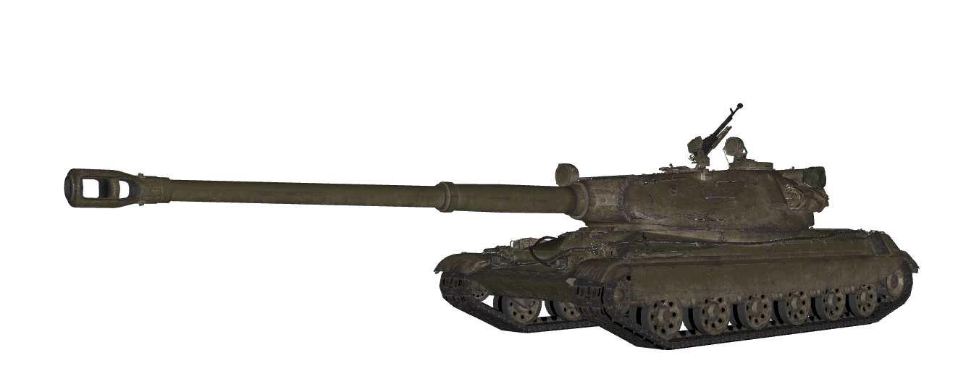

60TP Lewandowskiego
T-84
Progetto 54
Type: Heavy
Nation of Origin: Poland
First Produced: 1956
Health: 3000
Firepower: 1000
Reload Time: 5 seconds
Top Speed: 35 km/h
Heavy tank with powerful gun. Takes a while to reload.
Type: Heavy
Nation of Origin: Ukraine
First Produced: 1994
Health: 3600
Firepower: 1000
Reload Time: 3 seconds
Top Speed: 60 km/h
Ukrainian tank based on the Soviet T-80. Good armour and penetration.
Type: Heavy
Nation of Origin: Italy
First Produced: 1954
Health: 2500
Firepower: 600
Reload Time: 5 seconds per shell
Top Speed: 45 km/h
Features the “Italian revolver” autoloading mechanism. Reload empty shells by hitting the E key at any point.

